Slide 1

AGILE DEVELOPMENT by marwan

Slide 2

Agile team and their roles
Scrum Master
Facilitates team communication, removes roadblocks
Product Owner:
Represents the customer, maintains the product backlog
Developers:
Build the product based on user stories and sprint goals
Testers:
Ensure functionality meets requirements and quality standards

Slide 3
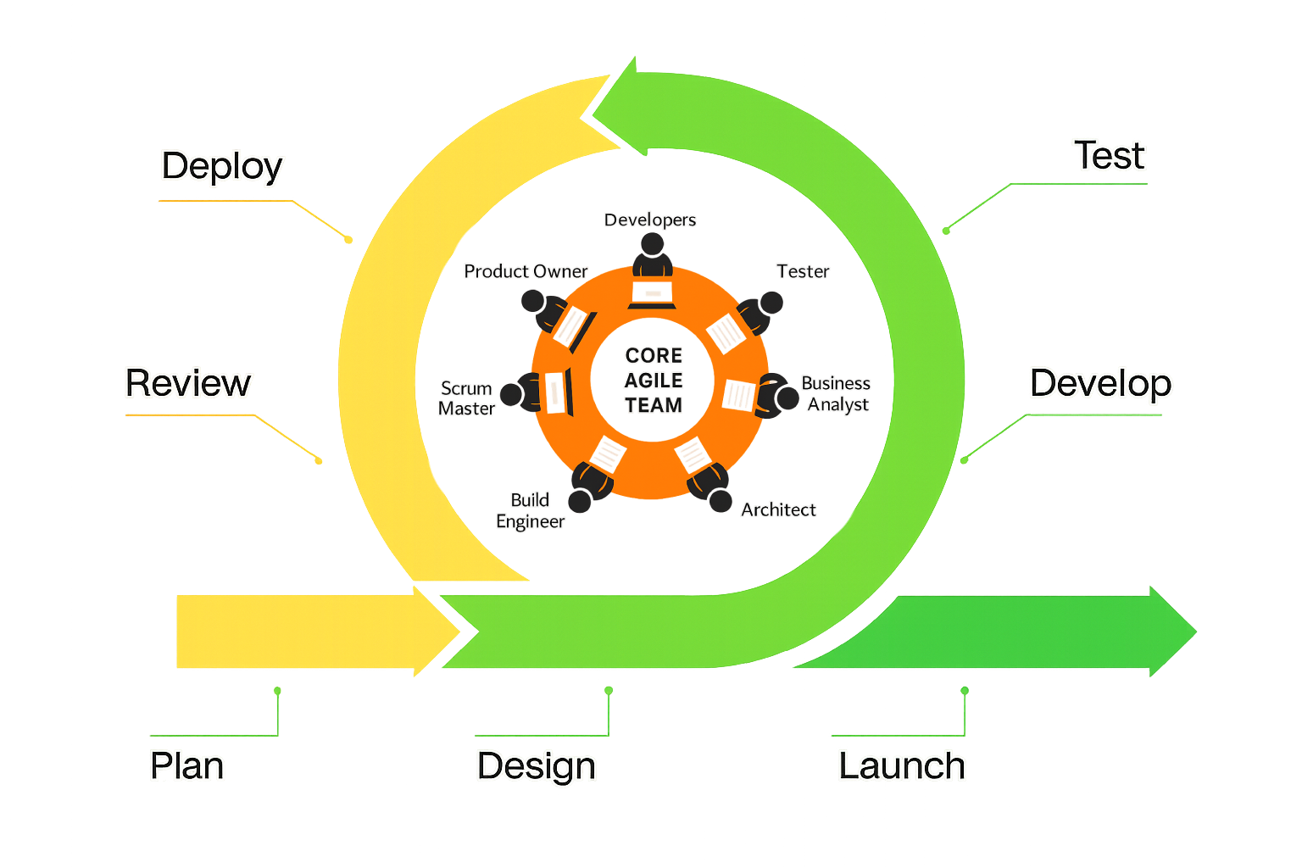
Agile Software Development Life Cycle (SDLC)
Planning:
Create product backlog and prioritize user stories
Design:
Collaborate on solutions and technical needs
Development:
Build working increments in sprints
Testing:
Test frequently using test cases and user feedback
Release:
Deliver shippable product increments regularly

Slide 4
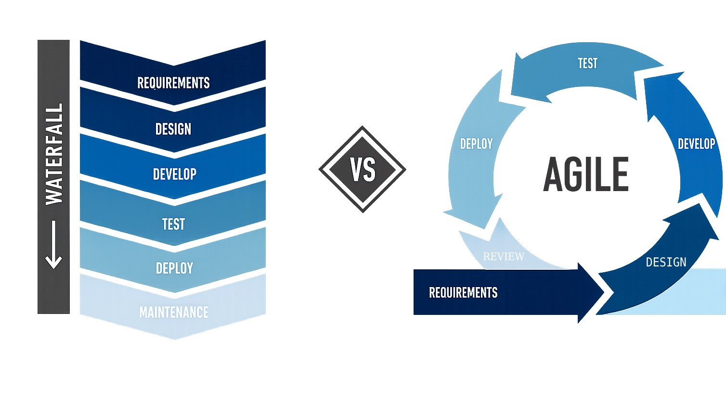
Agile vs. Waterfall

Slide 5
Waterfall vs. Agile: What’s the Difference?
Agile:
Waterfall:
- Flexible and adaptive
- Iterative with continuous feedback
- Encourages collaboration and user involvement
Linear & sequential
Little customer input once development starts
Harder to adapt to change

Slide 6
When to Use Waterfall vs. Agile
Use Waterfall when:
Use Agile when:
Fixed requirements and scope
Strict timelines and budgets
Projects with heavy documentation needs
Projects with changing requirements
Need for frequent user feedback
Teams that value collaboration and iteration

Slide 7
References
Charles G. Cobb. The Project Manager’s Guide to Mastering Agile : Principles and Practices for an Adaptive Approach. Wiley; 2015. https://research.ebsco.com/linkprocessor/plink?id=7668dde5-7ba6-35a3-8cf4-b4aeb8440d2d
Scrum.org. (2023). Scrum Guide. https://www.scrum.org/resources/scrum-guide
Agile Alliance. (2024). Agile 101
https://www.agilealliance.org/agile101
Leather, E. (2018b, May 22). Amazonian Agility - Frontira | Strategy & Implementation - Medium. Medium. https://medium.com/frontira/amazonian-agility-e3720ff004f7

Slide 8
THANK YOU

